Slide 1

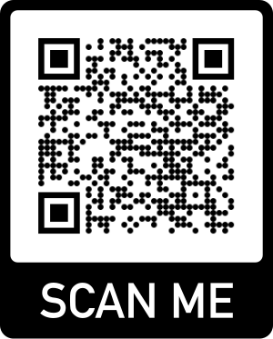



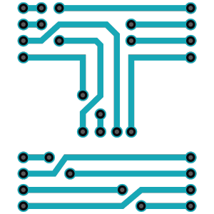
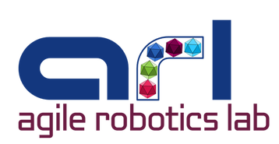
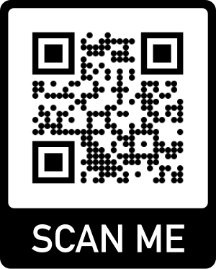

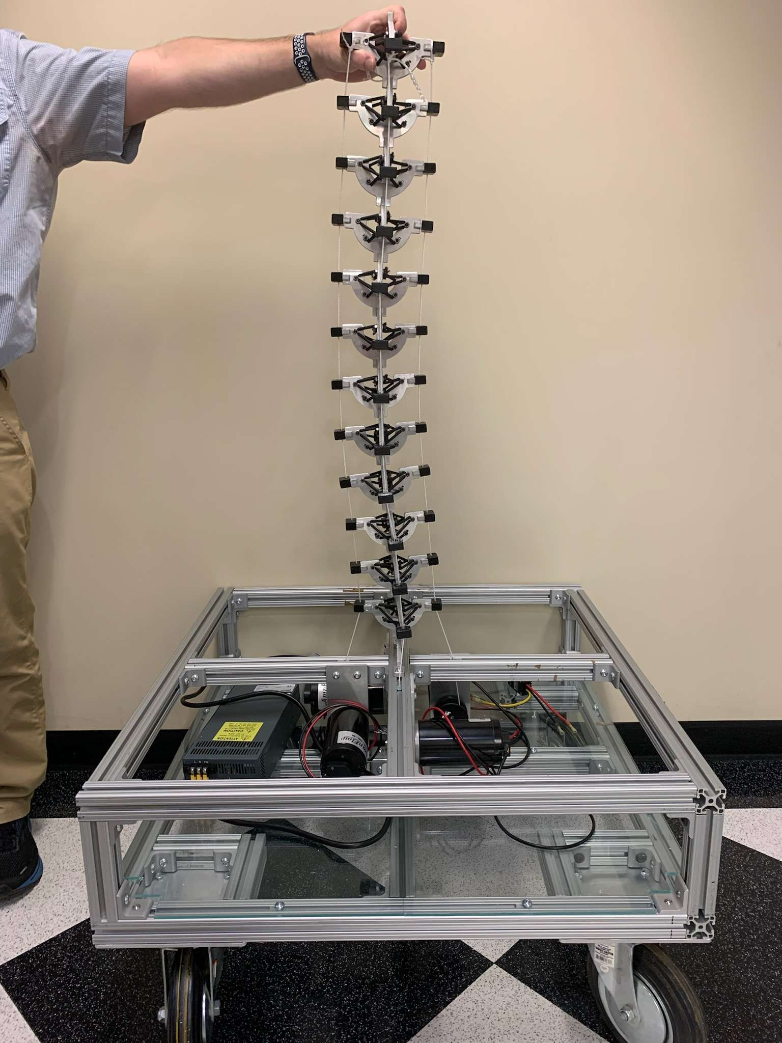
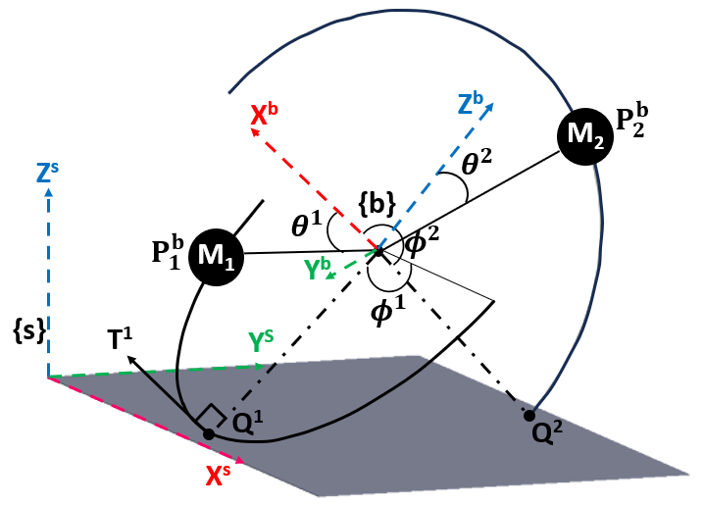
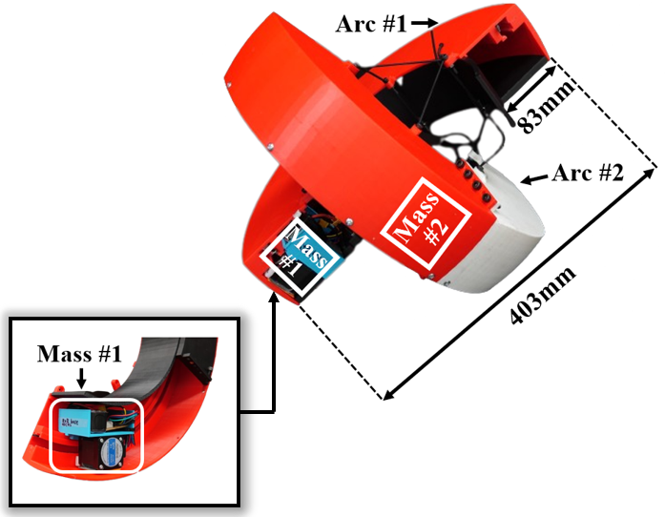
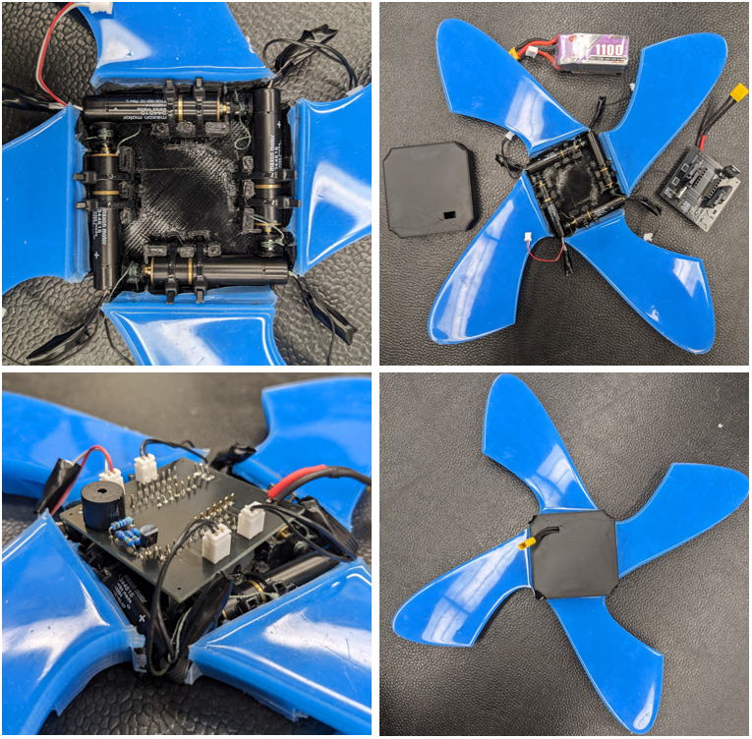
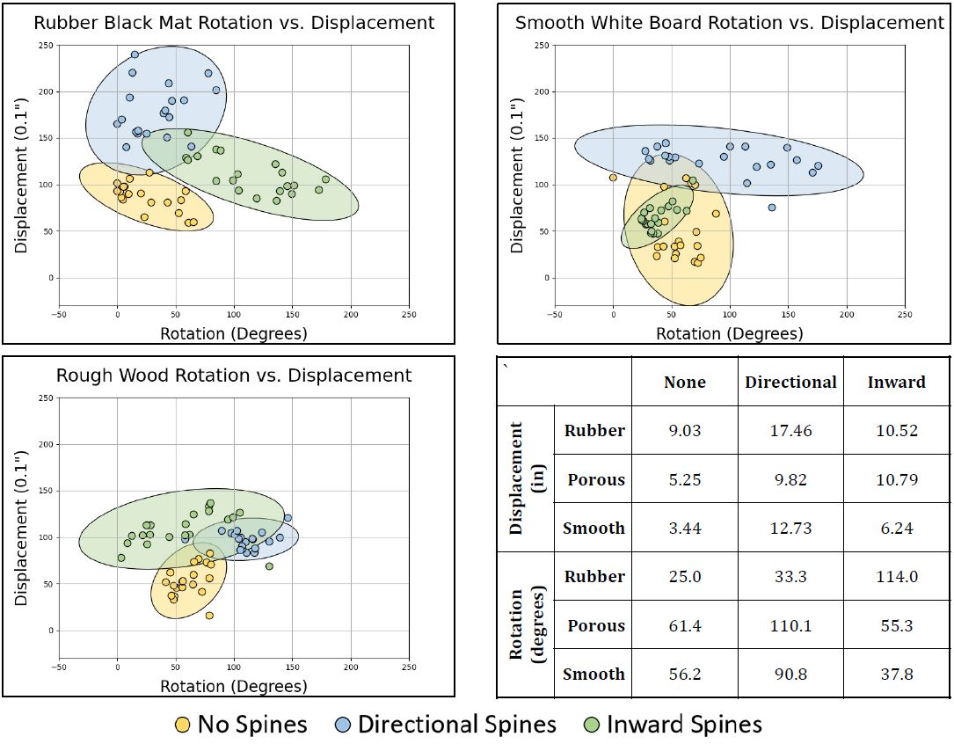
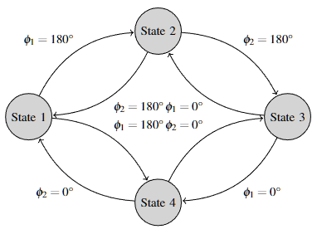
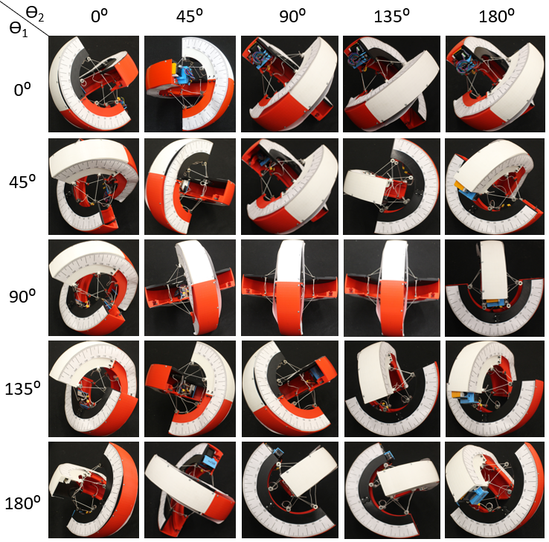
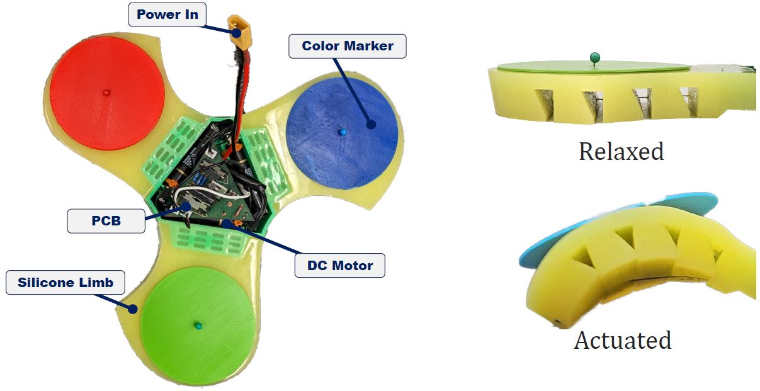
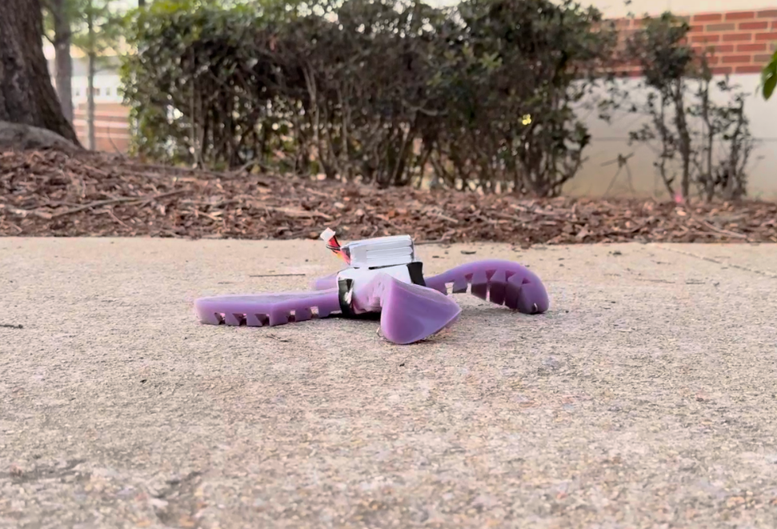
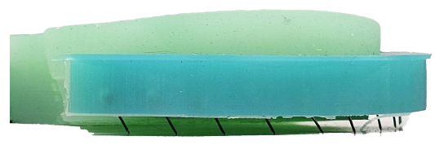
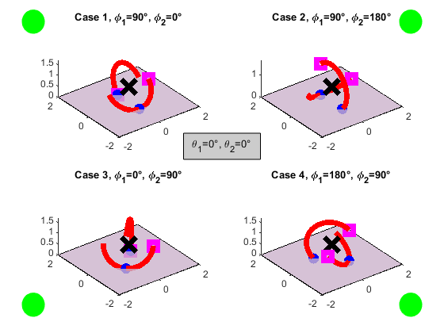
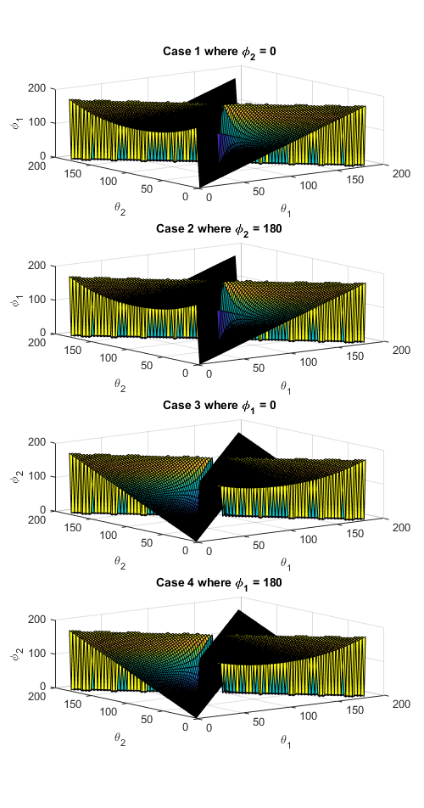
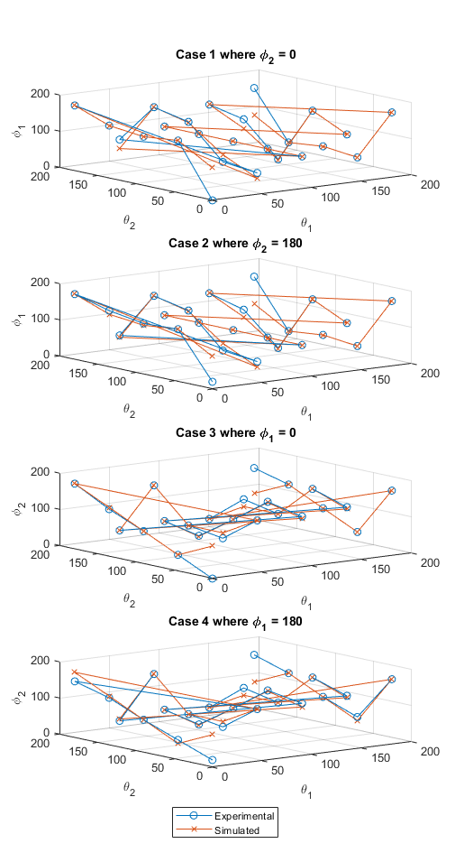
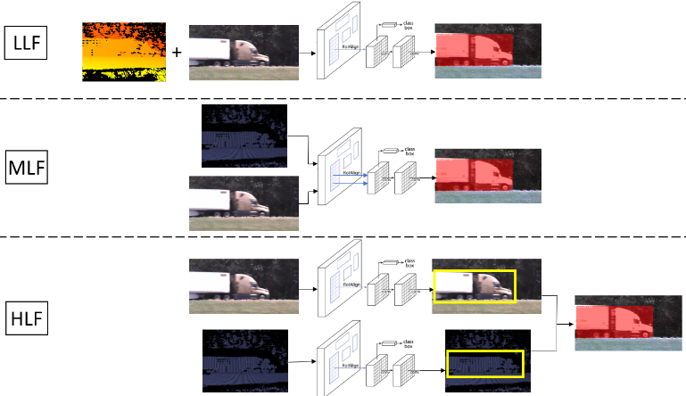
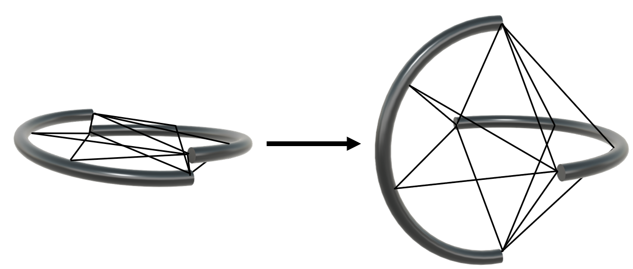
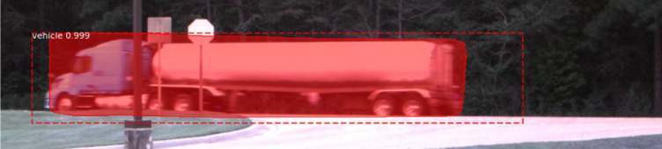
Lauren Elizabeth Ervin
University of Alabama
The iREDEFINE workshop is supported by NSF grant #2321316
LinkedIn
Agile Robotics Lab
Education
General Research Area
Research Contributions
University of Alabama – Doctor of Philosophy in Electrical Engineering 2020 – expected graduation 05/2025
NASA Alabama Space Grant Consortium (ASGC) Fellowship Renewal 2023 – 2024
NASA Alabama Space Grant Consortium (ASGC) Fellowship 2022 – 2023
University of Alabama – Bachelor of Science in Electrical Engineering with a Computer Option and a Math Minor 2016 – 2020
NSF Learning in Advance Scholarship 2018 – 2020
University of Alabama Foundations of Excellence Scholarship 2016 – 2020
University of Alabama Engineering Scholarship 2016 – 2020
Mobile Robotics
In recent years, mobile robot systems have become increasingly more advanced and varied. Generally, they are tetherless platforms capable of locomotion and equipped with some combination of proprioceptive and exteroceptive sensors. They can perform a variety of tasks depending on the specific application. Three subcategories are discussed below.
Tensegrity
Tensegrity robots utilize the tensegrity design principle: a structure is comprised of rigid struts under compression with prestressed members held in tension to achieve structural integrity. Tensegrity structures are lightweight, packable, impact resistant, and internally stable, making them ideal candidates for locomotion in unstructured environments such as search and rescue or space applications. Mobile robots comprised of tensegrity structures generally consist of 2 – 12 straight rods as the rigid struts, although prototypes with curved members exist as well. Locomotion is performed by either altering the cable lengths or shifting internal masses.
Soft
The field of soft robotics (SoRo) is relatively new, but there has been a rapid exploration into the benefits of using soft materials including flexibility, adaptability to the environment, shock absorbing capabilities, and safe human interaction. Due to the high degrees of freedom present in soft bodies, SoRos are notoriously difficult to model, control, and fabricate in a repeatable and consistent manner.
Wheeled
Traditional, wheeled robots tend to be rigid and reliable with well understood and fairly simple control schemes. However, their major drawback is difficulty locomoting in certain types of unstructured terrain.
Computer Vision
CV is used for analyzing data (images, point clouds, etc.) and then performing a task such as object detection/tracking, semantic segmentation, pose estimation, and more.
Tensegrity Exploratory Robot (TExploR)
TExploR is a bi-arc, mobile, tensegrity robot comprised of rigid, semi-circular links that maintain structural integrity using pre-stressed cables. Pure rolling locomotion is achieved via an internal mass shifting along each arc. The discontinuous, curved morphology provides balance between efficient rolling locomotion and stability. The robotic platform is statically modeled using Lie Groups., and a holonomic constraint proves that TExploR is a two point of contact hybrid system switching between four independent states.
Stability tests for each state are simulated and validated with an experimental prototype resulting in an average of 3.59° of error. Future dynamics experiments using a Newton Euler approach will be performed. A new, robust prototype utilizing electromagnetic rails as the actuation mechanism for shifting the internal masses is currently being built. Shape morphing to enable controllable tilt angles and vision payload integration are research efforts that will be completed in the future.
Agriculture Robot (AgBot)
A combination wheeled and tensegrity robot
was designed for agriculture applications.
AgBot utilizes a rigid platform base with
drivable wheels and heavy components
mounted (PSU, geared motors, etc). Atop the
base is a continuum, tensegrity manipulator
actuated via motor tendon actuators (MTAs).
Currently the shape morphing is manually
controlled via a wireless Xbox controller, but
inline load cells will be integrated to enable
feedback control. The addition of auxiliary
sensors for path planning, the completion of
dynamic modeling of the system, and field
tests remain future works.
Untethered Terrestrial Soft Robot (uTerreSoRo) & Microspines
The mechatronics design and repeatable fabrication methodology of the uTerreSoRo offers a low-power, tetherless solution to exploratory SoRos. The addition of an array of microspines, small spines commonly found on insect legs that reinforce surface interaction by engaging with asperities, increases the traversability capabilities of the uTerreSoRo. A repeatability analysis investigating the efficacy for 3 different microspine configurations on 3 different surfaces is performed.
Semantic and Instance Segmentation
Both semantic and instance
segmentation were performed
on hybrid camera + LiDAR
data. Sensor fusion was
performed with low-level
fusion (LLF), requiring both
intrinsic calibration of each
sensor as well as extrinsic
calibration to enable
multi-modal fusion. The Mask
R-CNN network architecture
was used. Segmentation will
be integrated into the robots
above for obstacle avoidance.
Teaching Experience
Graduate Instructor for ME456/ME556 Mechatronics in Fall 2023. This is an advanced undergraduate/introductory graduate course in the field of Mechatronics and Robotics covering electronics, microcontroller programming + interfacing, data acquisition, sensing, and actuation. I wrote the material for and lectured one of the three modules covered in the class: Raspberry Pi and Fundamentals of Python. I additionally wrote one of the three labs where students performed real-time object tracking with OpenCV on Raspberry Pis. There were multiple lab days for all three labs where I assisted students with any questions they had as well as debugged their code. The final component of the course was a semester-long, exploratory project and I served as an advisor for 7 of the 11 projects.
Graduate Teaching Assistant for ECE380 Digital Logic in Spring 2021. This is an advanced undergraduate course discussing logic gates, sequential circuit building on breadboard + simulating in Quartus Prime, K-maps, VHDL, and FSMs. I taught all 9 labs and answered questions + debugged code during lab sessions. I also graded all the lab demos and reports.
Professional Development Awards
Select Publications
Engineering Council of Birmingham Electrical Engineering Graduate Student of the Year – 2024
NSF Impact: Redefining Electrical and Computer Engineering Faculty (iREDEFINE) Professional Development Award – 01/2024
1st place in UA ECE Graduate Research Poster Competition – 12/2023
NSF Broadening Participation (BPart) Fellowship – 06/2023
“Dynamic Modeling of Spherical Mobile Tensegrity Robot with Nonholonomic Rolling Constraint Using a Newton Euler Approach.” In preparation for IEEE Transactions on Robotics.
“Grip Stability of Passive Microspines for Soft Robots and an Analysis of Repeatability and Reliability.” In preparation for ASME Journal of Mechanisms and Robotics.
“Static Modeling of Spherical Mobile Tensegrity Robot Using Lie Groups with Nonholonomic Rolling Constraint.” Submitted to IEEE Robotics and Automation Letters 03/2024.
“Comparison of Lidar Semantic Segmentation Performance on the Structured SemanticKITTI and Off-Road RELLIS-3D Datasets.” Submitted to Springer International Journal of Intelligent Robotics and Applications 01/2024.
“UA_L-DoTT: University of Alabama’s Large Dataset of Trains and Trucks.” Data in Brief 06/2022.
Leadership
Co-Founder and President of the UA ECE Graduate Student Association 2023 – 2024
Lead of ECE Ambassadors at UA 2020 – 2022

